Slide 1
Options for following along on your device:
Snap the QR code
Go to the link
Click on the summit website link
https://goo.gl/z83W5w
Notes:
Diana

Slide 2
Learning Language Through Grade-Appropriate Content:
The High School Newcomer’s Challenge
Kathryn Thomas, M.Ed., ELD Content Specialist
Diana Nguyen, M.A.Ed., ELA/Literacy Content Specialist
Campbell Union High School District
October 24, 2015
Notes:
NOTES:
D = first introduction -- Name, role, years in education
K = second intro + segue into title and reasoning for teaching summer bridge -- seeing ELD standards in action

Slide 3
Topics
Program Design and Implementation
Student Work
Non-negotiables and Recommendations
Notes:
Kathy

Slide 4
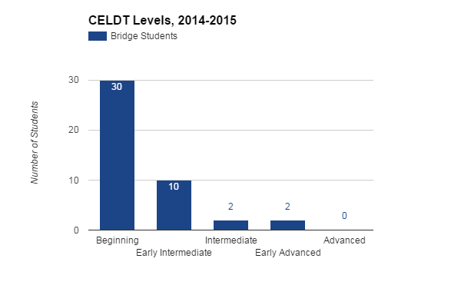
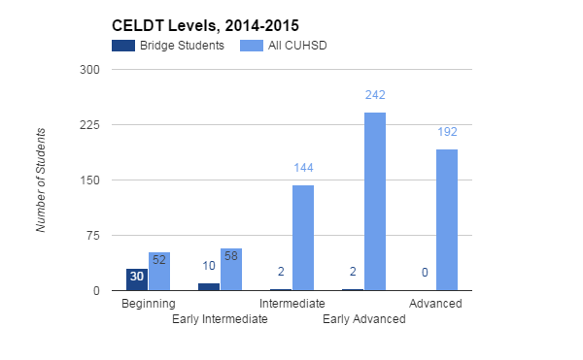
Student Demographics
ELD Summer Bridge Program, 2015
Notes:
Kathy
For more demographic data, see slides 33-37
NOTES:
Disproportionate # of beginning vs. int./early adv. enrolled in summer bridge

Slide 5
Program Design and Implementation
Notes:
Kathy

Slide 6
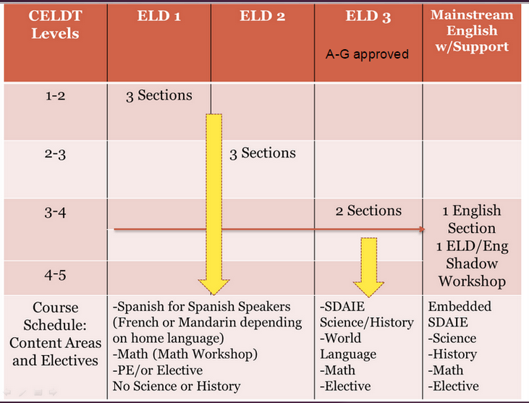
CUHSD ELD Course Pathway
Notes:
Kathy

Slide 7
Purpose
ELD 1
ELD 2
ELD 3
English 1-4 w/ support
College or Career
Strengthen and build skills so that students can be successful in the next level of ELD or in college-prep English
Notes:
NOTES
Experiment with a text-based and integrated approach
High rigor, high support
Observe the new EL standards in action w/CUHSD students

Slide 8
Design
Time (M-Th; 5 weeks) | 7:30am-10:30am | 10:50am-1:50pm
CELDT Levels | Beginning | Beginning to Early Advanced
Number of Students | 19 | 25
Number of Adults | 2 classroom teachers; 1 bilingual aide
Resources | 1 Chrome cart ; 1 document camera; 1 projector and clicker; miscellaneous materials
Daily Structure | (1) Vocabulary and background building (2) Grammar time (focus on subordination and coordination) (3) Pre-reading / interacting with text / extending understanding
Notes:
Characteristics of Adults:
Teachers
Practitioners and researchers -- lifelong learners; risk-takers
Bilingual
English teachers w/background in AP English Language
Comfortable with technology
Bilingual Aide
Background in SpEd
Little to no prior knowledge of literacy or CCSS standards for ELA/literacy and ELD
Bilingual -- fluent in Spanish and English
Buy-in -- gave input re: lessons, instructional decisions, etc.
Relied on translation for Spanish-speaking students, esp. CELDT 1
Instrumental in finding out more about students

Slide 9
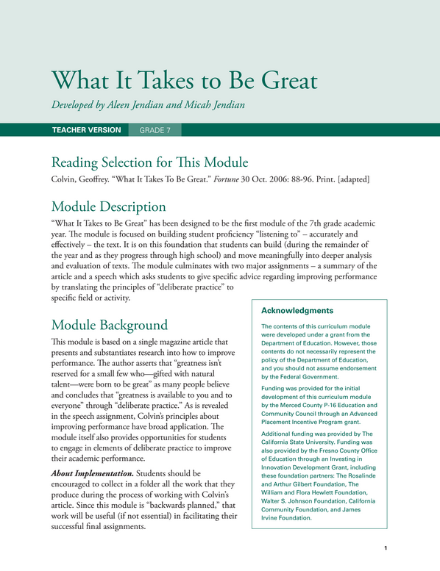
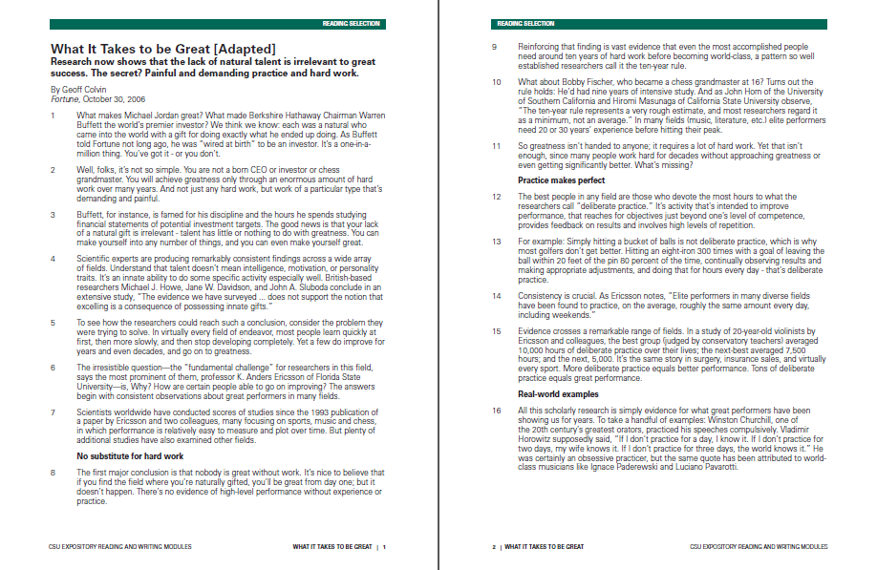
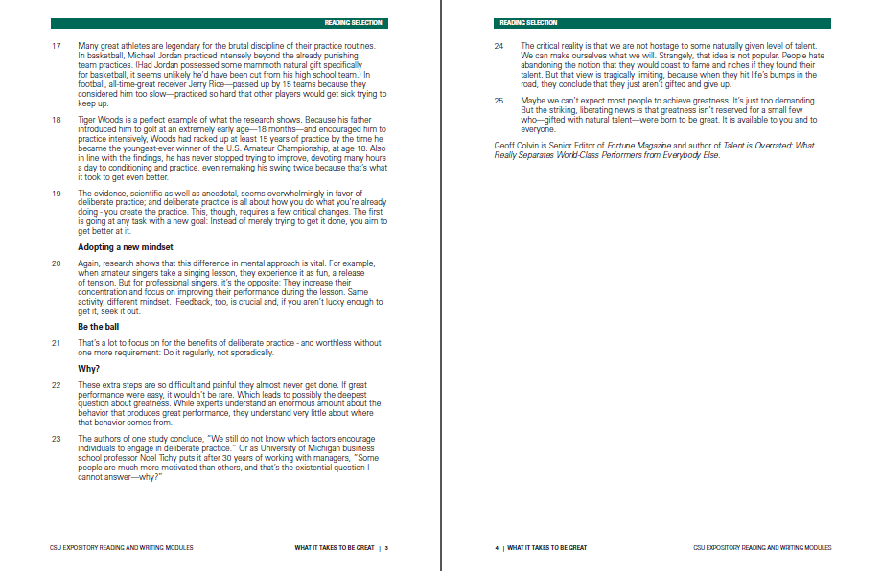
Curriculum: ERWC
Expository Reading and Writing Course (ERWC) 7th Grade Unit
Estimated Lexile measure: 1210L
Additional text modifications
Supplemental texts:
Speech
Video
News article
Supplemental tasks:
Speaking and listening
Writing
Notes:
NOTES
Original text was modified to be more accessible to 7th graders
Unit includes scaffolds to increase accessibility of the text
Supplemental tasks and texts = synthesis

Slide 10
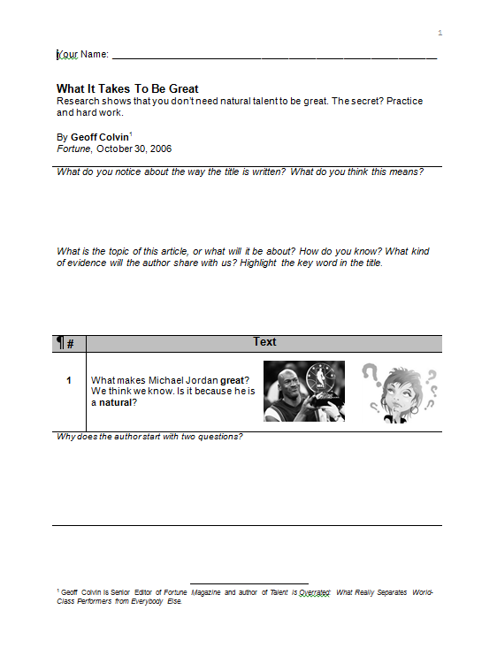
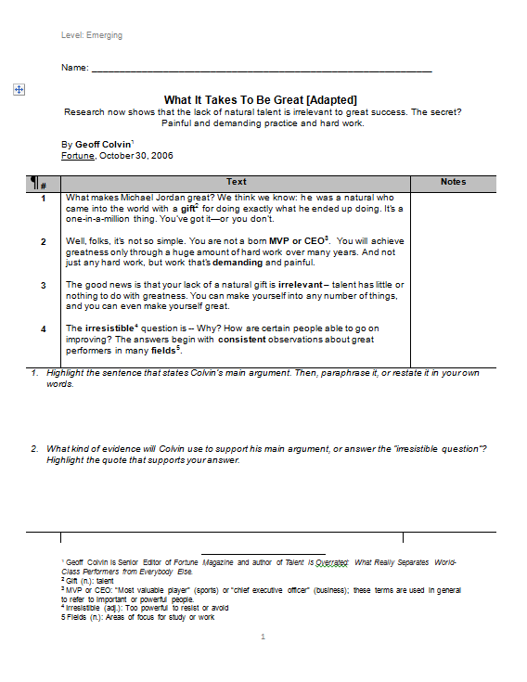
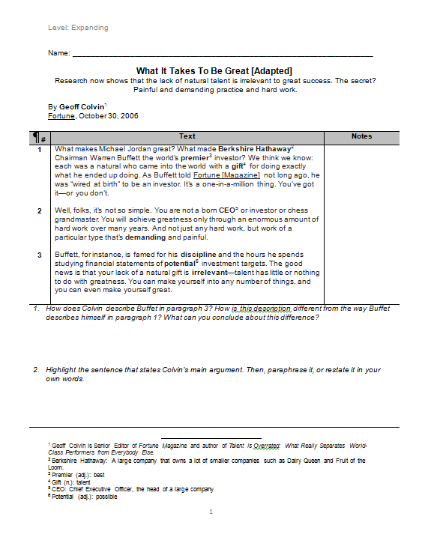
Modified Texts
Beginning Level
Emerging Level
Expanding Level
Notes:
NOTES
Original text was modified to be more accessible to 7th graders
Unit includes scaffolds to increase accessibility of the text
Supplemental tasks and texts = synthesis

Slide 11
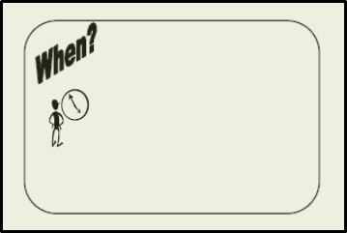
Curriculum: WRITE Institute Gist Summary
Notes:
WRITE curriculum re: summary writing
Graff template

Slide 12
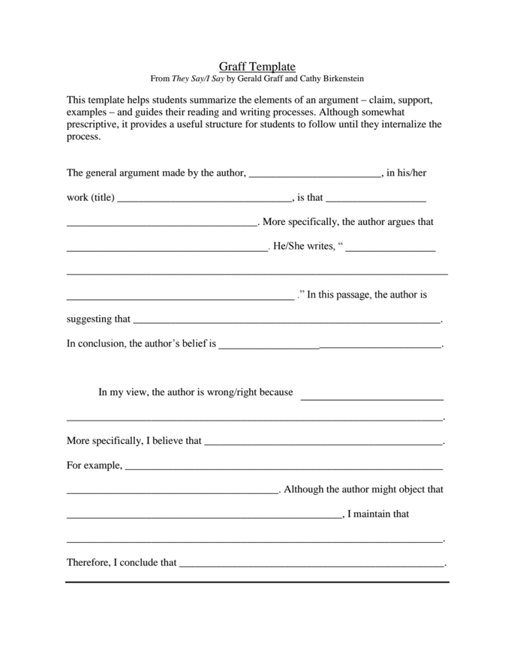
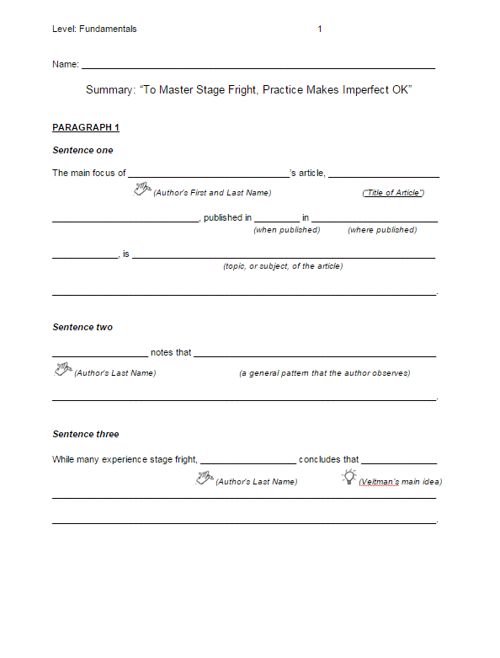
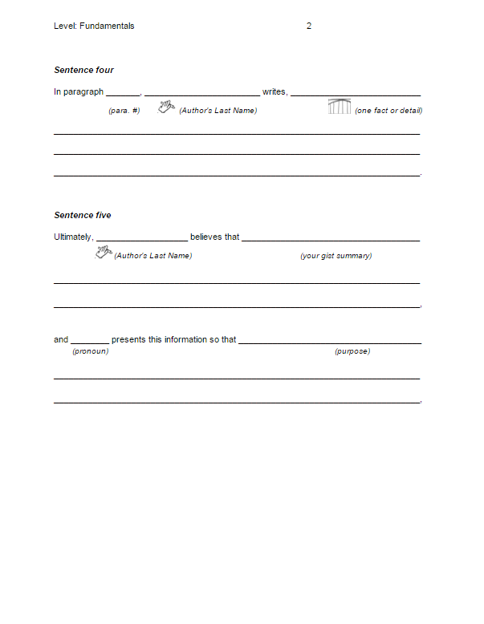
Curriculum: Modified Graff Template
Original Graff Template,
They Say, I Say
Sample Modification,
Fundamentals Level
Notes:
WRITE curriculum re: summary writing
Graff template
Paragraph 1 = summary
Paragraph 2 = opinion

Slide 13
Module Objectives
Cite textual evidence
Identify the development of the main idea throughout a text
Write a precise and accurate summary of a text
Apply the author’s central ideas to another text
Create and present a speech

Slide 14
Rationale
Age-appropriate, culturally relevant, and inspiring topic
Vetted, reputable curricula
Rich, non-fiction texts to support language acquisition and skill-building
Scaffolded writing instruction
Integrated approach in a designated setting
Notes:
NOTES

Slide 15
Samples of Student Work

Slide 16
QUESTION
Do you agree that greatness is available to everyone? Why or why not? Use at least one example of a person we’ve talked about to support your answer.
Speaking Practice
CELDT 1
Notes:
NOTES:
2nd week of summer program
Context:
Quickwrite, watched videos of great people and discussed what made them great (EdPuzzle) -- pair shares w/stems and class discussion
Wrote about the question FIRST and then read and recorded what they wrote

Slide 17
TEXT
On June 26, 2015, Chloe Veltman a musician and writer wrote an article for the New York Times and Los Angeles Times “To Master Stage Fright, Practice Makes Imperfect Ok.”
Gist Summary, Supplemental Text
CELDT 1
Notes:
Practice for summative

Slide 18
TEXT
On June 26, 2015, Chloe Veltman wrote an article for the NPR News titled “To Master Stage Fright, Practice Makes Imperfect Ok” because she wanted to help people how to master stage fright.
Gist Summary, Supplemental Text
CELDT 1

Slide 19
Formative Writing Sample
Student A, CELDT 1
Notes:
Describe one thing you do well and one thing you wish you could do better.
Written on first day of school.

Slide 20
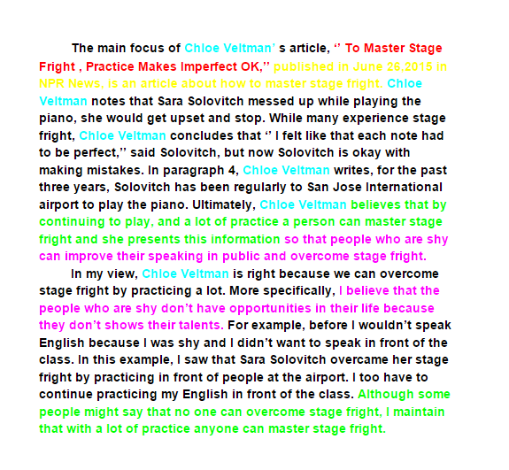
Summative Writing Sample
Student A, CELDT 1
Notes:
Explain colors
This student wrote the second paragraph by choice -- beginning level was only required to write the first paragraph

Slide 21
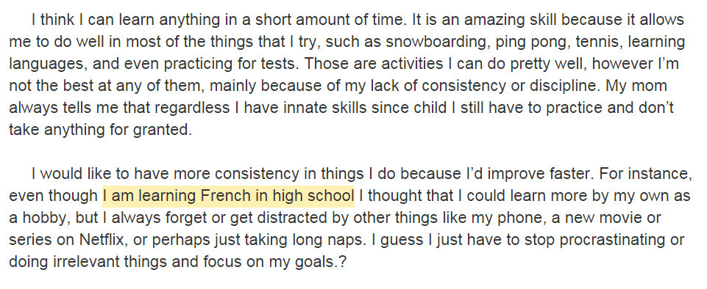
Formative Writing Sample
Student B, CELDT 3

Slide 22
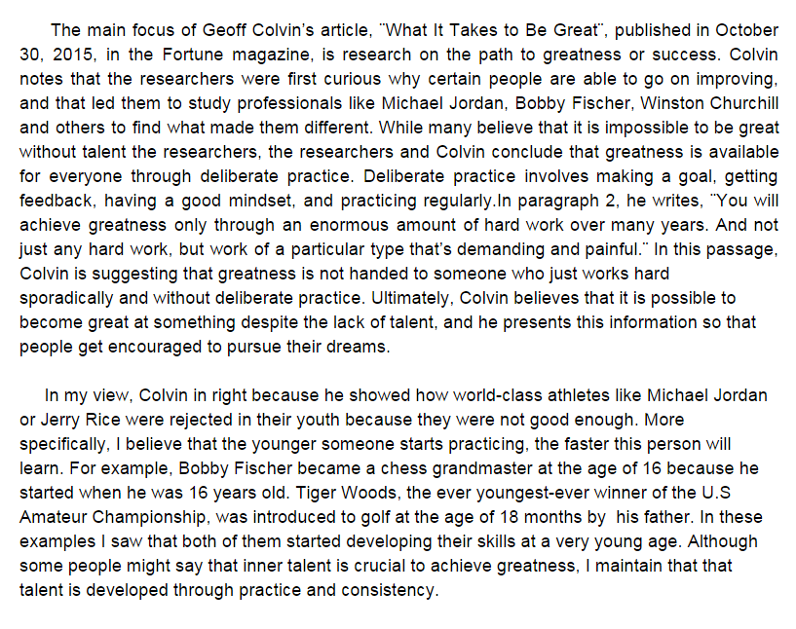
Summative Writing Sample
Student B, CELDT 3
Notes:
Fewer scaffolds -- student did not rely heavily on sentence frames

Slide 23
Summative Writing Samples
Student A and Student B Comparison

Slide 24
Final Speech
CELDT 1

Slide 25
Non-Negotiables and Recommendations
Notes:
NOTES
All teachers are teachers of ELs and literacy.
Master schedule design and programming must be purposeful and strategic.
Teacher mindset and self-efficacy contributes to student success.
All adults must share the same vision and expectations.
---------------------------------------------------------------------------------------------------------------------------------------------------------------------
Instructional implications
Structural implications
Budget
Collaborative time
Flexible scheduling
Mindset/expectation
Teacher’s self-efficacy
PD
Staffing
Placement
Take-aways:
All teachers are teachers of ELs
Programming (student schedules + design of master schedule); Multiple teachers -- staffing is essential + shared collaboration time
Mindset re: “readiness”
The role of translation
Recommendations for 2016 Bridge Program:
Common conception re: purpose of translation in the class
Availability of class list + student data in advance
Placement needs to be more targeted and purposeful:
Students who are in between the levels on the continuum (emerging/expanding, etc.)
Multiple measures
Better communication of purpose
Timeliness of recommendations
English teacher
Formative
2 field trips instead of 1; guest speaker

Slide 26
All teachers are teachers of ELs and literacy.

Slide 27
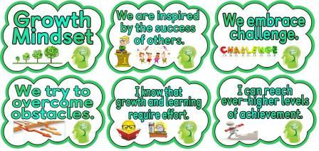
Teacher mindset and self-efficacy contributes to student success.

Slide 28
Scheduling design must be purposeful and strategic.

Slide 29
All adults must share the same vision and high expectations.

Slide 30
References
Graff, Gerald, and Cathy Birkenstein. They Say / I Say: The Moves That
Matter in Academic Writing. New York: W.W. Norton, 2010. Print.
Jendian, Aleen, and Micah Jendian. "What It Takes to Be Great."
Expository Reading and Writing Course | CSU. California State
University, n.d. Web. 11 June 2015.
“The Writing Reform and Innovation for Teaching Excellence.” WRITE
Institute. San Diego County of Education.

Slide 31
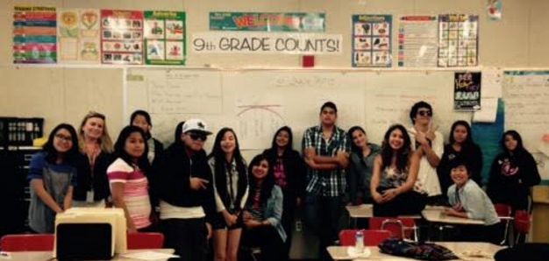
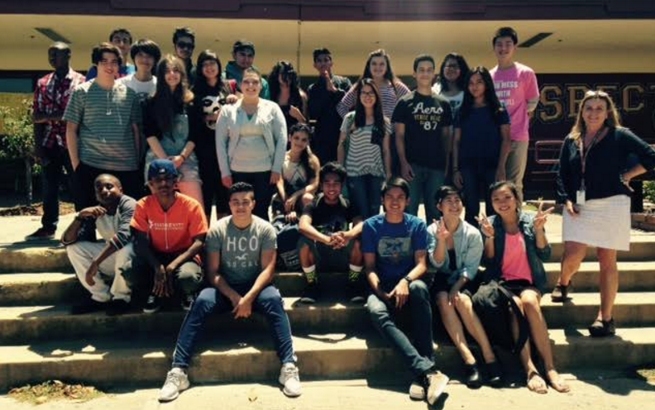
Contact Information
Diana Nguyen:
dnguyen@cuhsd.org
Kathryn Thomas:
kthomas@cuhsd.org

Slide 32
Student Demographics

Slide 33
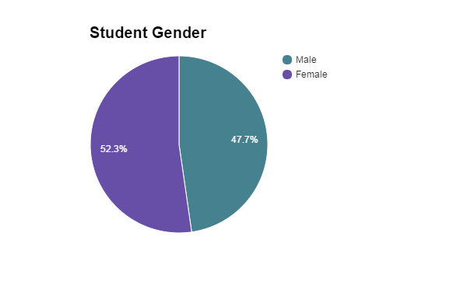
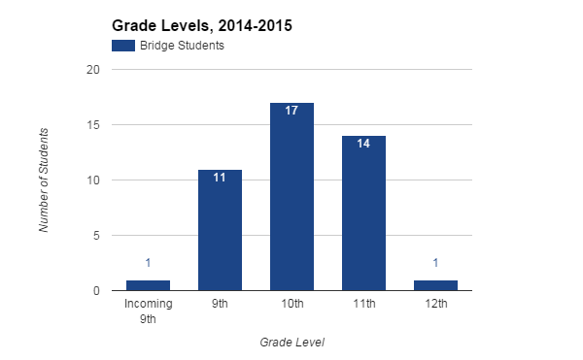
23
21
Student Demographics
ELD Summer Bridge Program, 2015

Slide 34
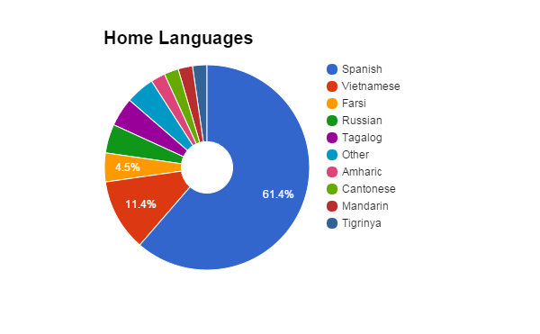
Student Demographics
ELD Summer Bridge Program, 2015

Slide 35
Student Demographics
ELD Summer Bridge Program, 2015
Notes:
NOTES:
Disproportionate # of beginning vs. int./early adv. enrolled in summer bridge

Slide 36
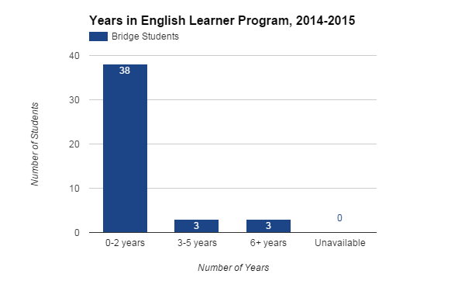
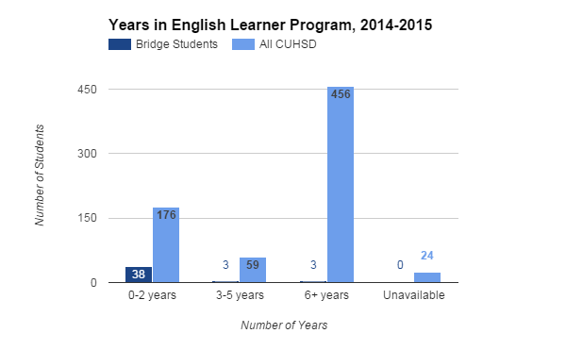
0.06%
21.6%
5%
Student Demographics
ELD Summer Bridge Program, 2015
Notes:
NOTES:
Disproportionality --
LTELs -- SpEd or mainstream, but not reclassified -- perhaps those students are already getting support?

